Slide 1
Temporal Difference Learning
CogPsi
2019/08/12
YK LEE

Slide 2
References
[1] Reinforcement Learning: An Introduction (2nd edition) by Richard S. Sutton and Andrew G. Barto
[2] Richard Sutton Lecture Notes: http://incompleteideas.net/609%20dropbox/slides%20(pdf%20and%20keynote)/11-12-TD.pdf

Slide 3
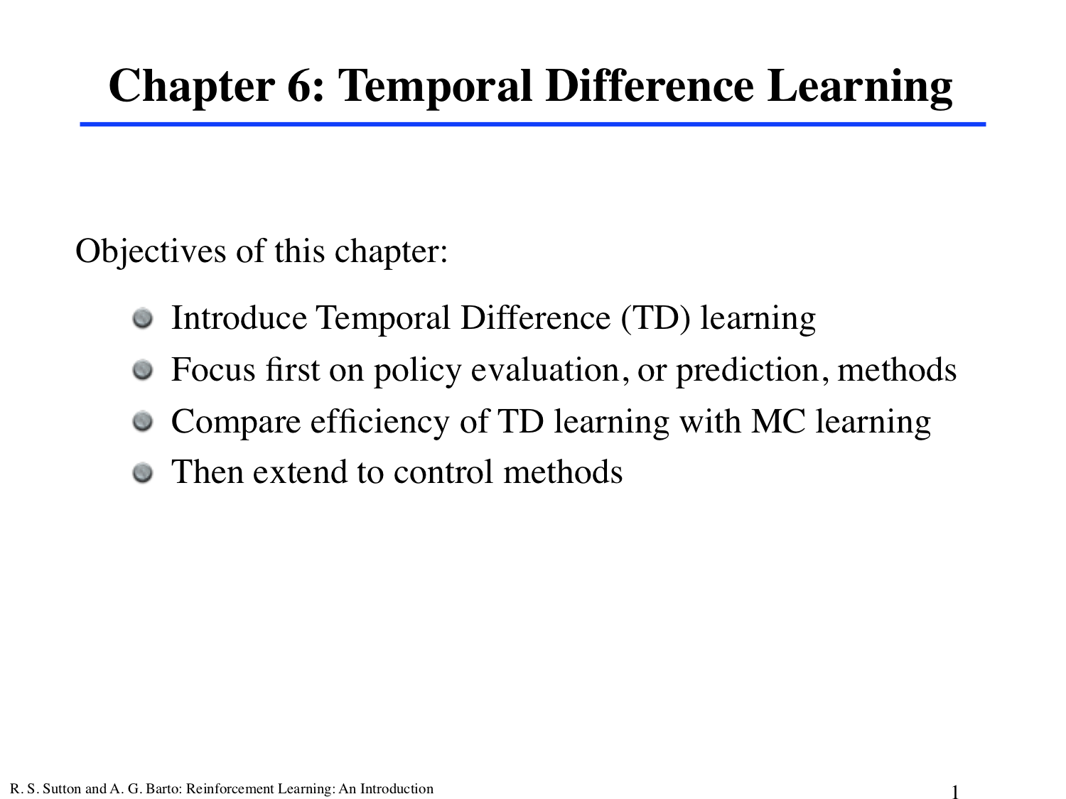

Slide 4
TD Learning
Combination of Monte Carlo ideas and dynamic programming ideas (DP)
Like Monte Carlo methods,
can learn directly from raw experience without a model of the environment’s dynamics (model-free)
Like DP:
Update estimates based in part on other learned estimates, without waiting for a final outcome (they bootstrap)

Slide 5
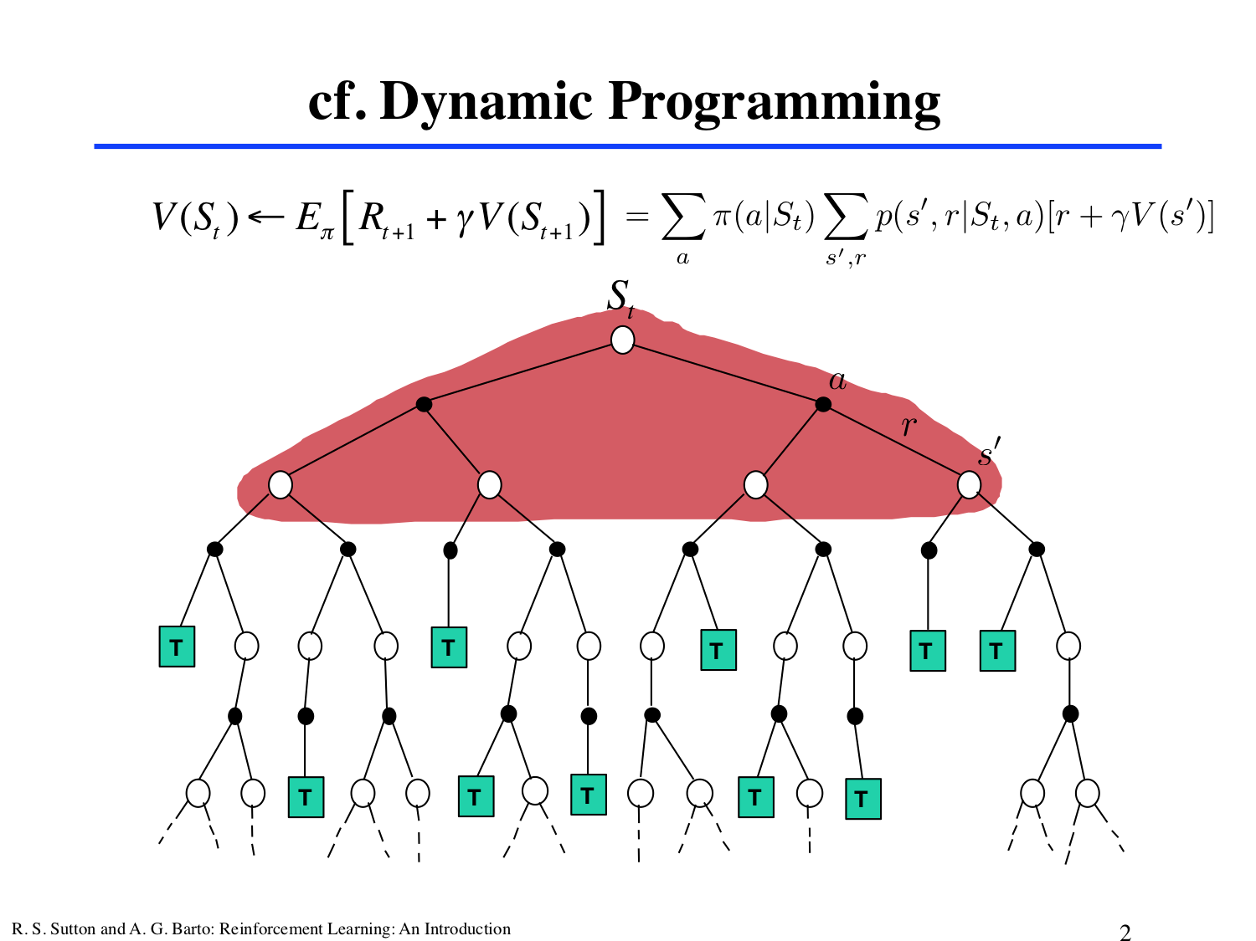

Slide 6
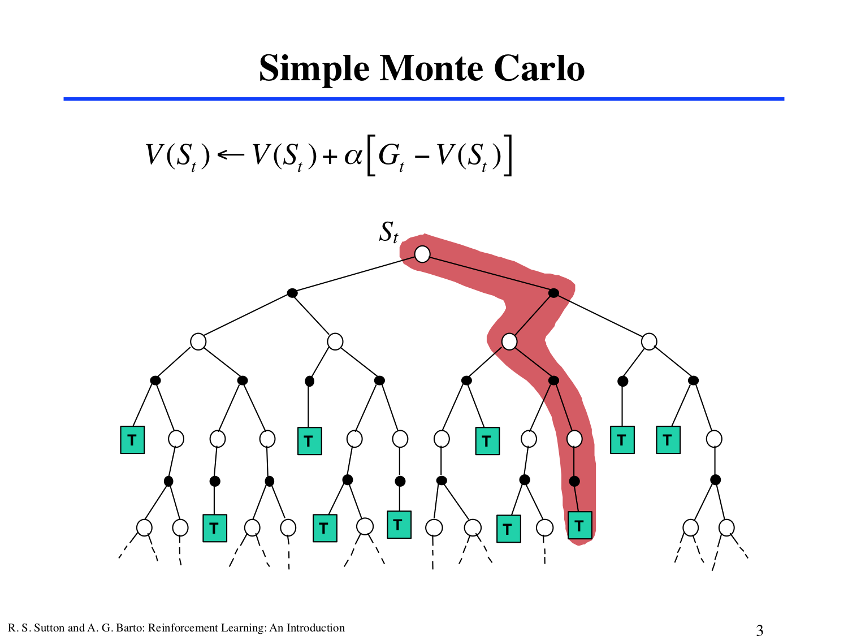

Slide 7
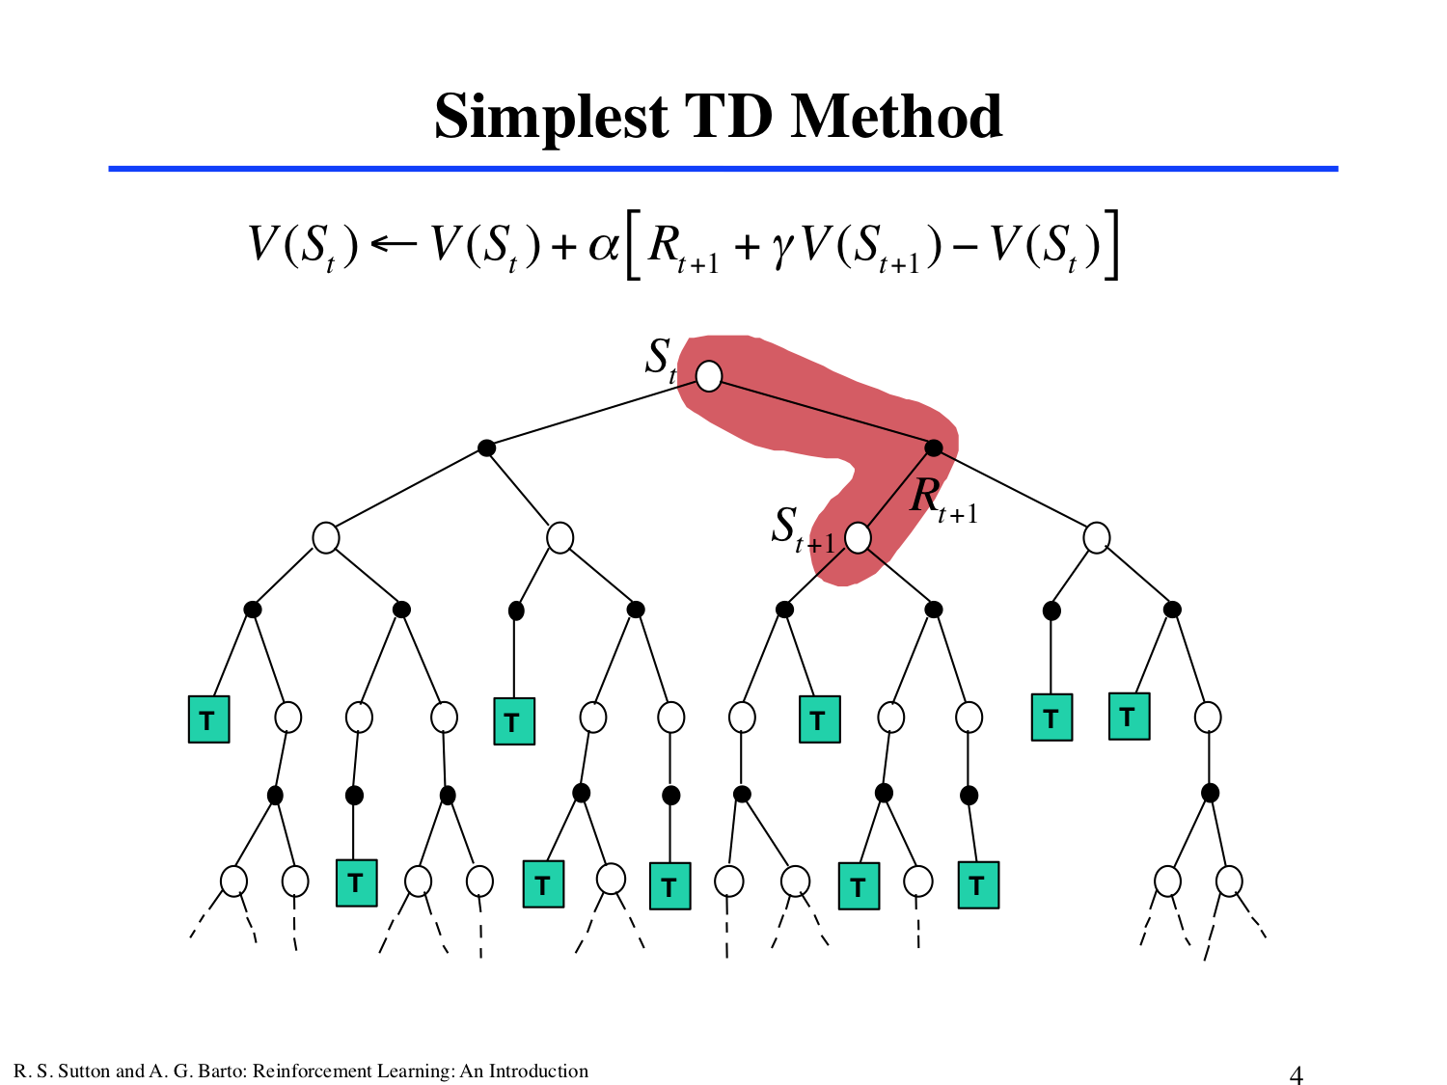

Slide 8
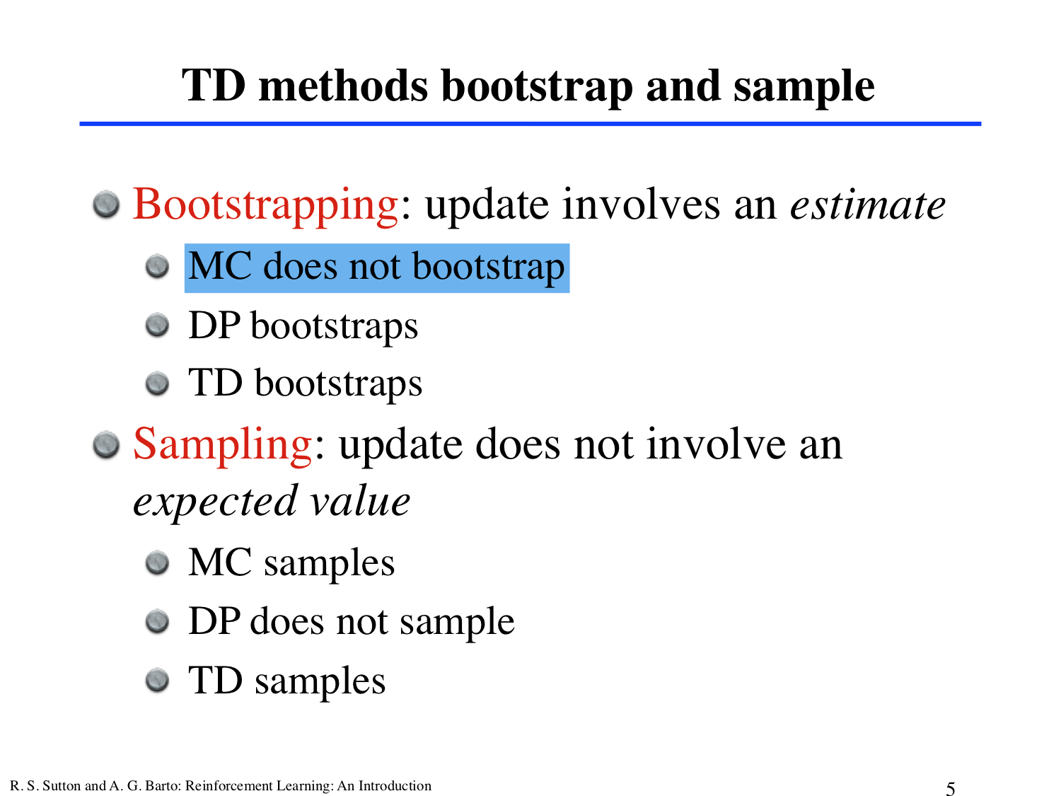

Slide 9
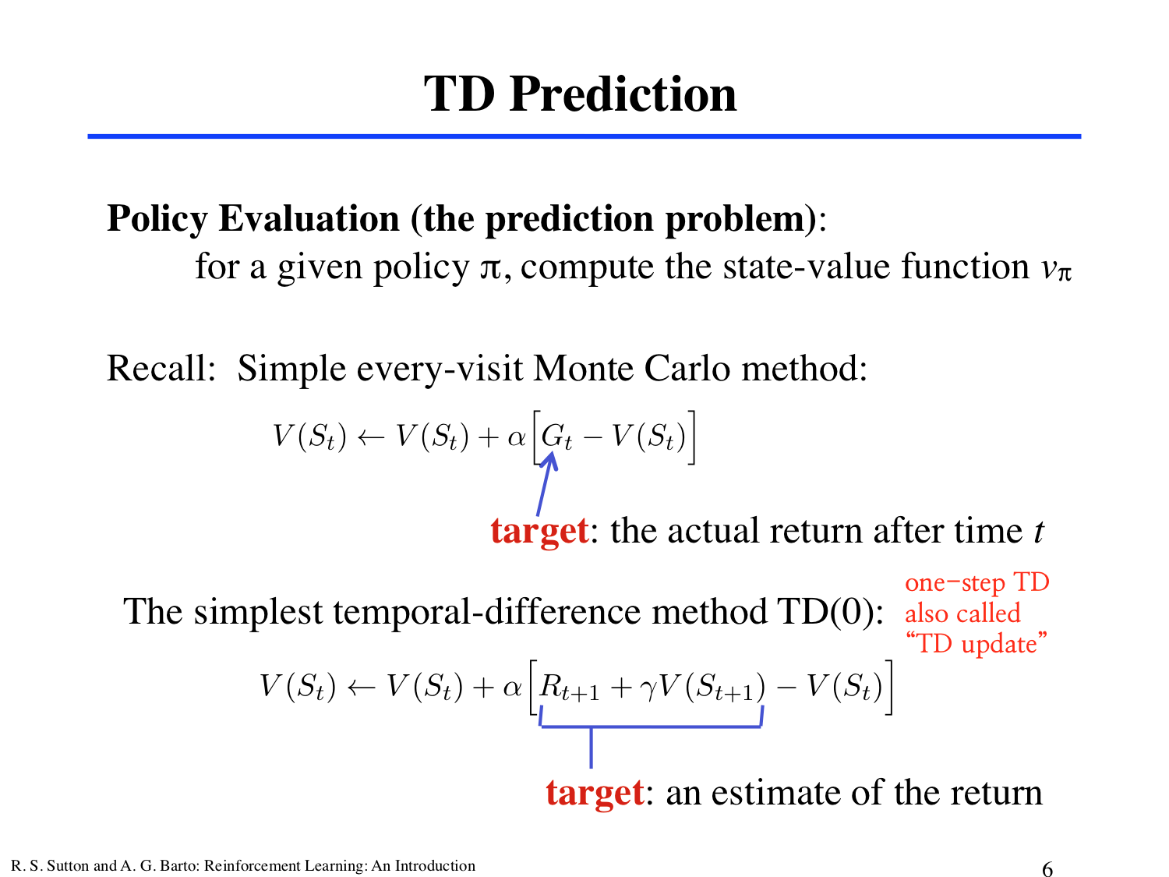
Notes:
Let’s start by focusing on policy evaluation or “prediction” problem :
Prediction problem: the problem of estimating the value function v(pi) for a given policy pi
For the ‘control’ problem (finding a optimay policy), DP, TD, and Monte Carlo methods all use some variation of generalized policy iteration.
The differences in the methods are primarily differences in their approaches
to the prediction problem.

Slide 10
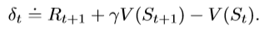
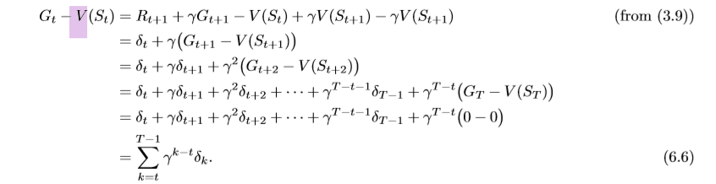
TD error
gamma_t is the error V(S_t), available at time t+1.
if the array V does not change during the episode (as it does not in MC methods), then the MC error can be written as a sum of TD errors.
Notes:
TD(0) update = sort of error, measuring the difference between the estimated value of S_t and better estimate R_t+1 + gammaV(S_t+1).
Notice that the TD error at each time is the error in the estimate *made at that time*. Because the TD error depends on the next state and next reward, it is not actually available until one time step later. That is, gamma_t is the error V(S_t), available at time t+1.

Slide 11
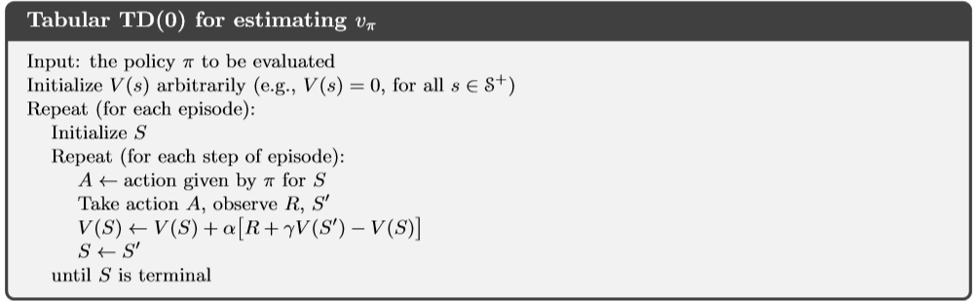
TD(o) in procedural form

Slide 12
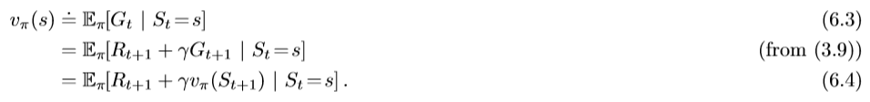
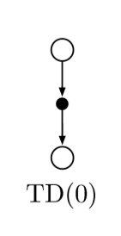
Target of MC
Target of DP
TD and Monte Carlo updates = sample updates
Different from expected updates of DP methods (= based on a single sample successor rather than on a complete distribution of all possible successors).
Tabular TD(0) =>
Notes:
[TARGET]
Because TD(0) bases its update in part on an existing estimate, we say that it is a bootstrapping method, like DP.
The MC methods use an estiamte of (6.3) as a target. The MC target is an estimate because the expected value is not known; a sample return is used in place of the real expected return.
whereas DP methods use an estimate of (6.4) as a target.
The DP target is an estimate not because of the expected values, which are assumed to be completely provided by a model of the environment, but because v(pi)(S_t+1) is not known and the current estimate V(S_t+1) is used instead.
---
Tabular TD(0)
The value estimate for the state node at the top of the backup diagram is updated on the basis of the one sample transition from it to the immediately following state.
---
Sample updates
Involve looking ahead to a sample successor state (or state-action pair), using the value of the successor and the reward along the way to compute a backed-up value, and then update the value of the original state (or state-action pair) accordingly.

Slide 13
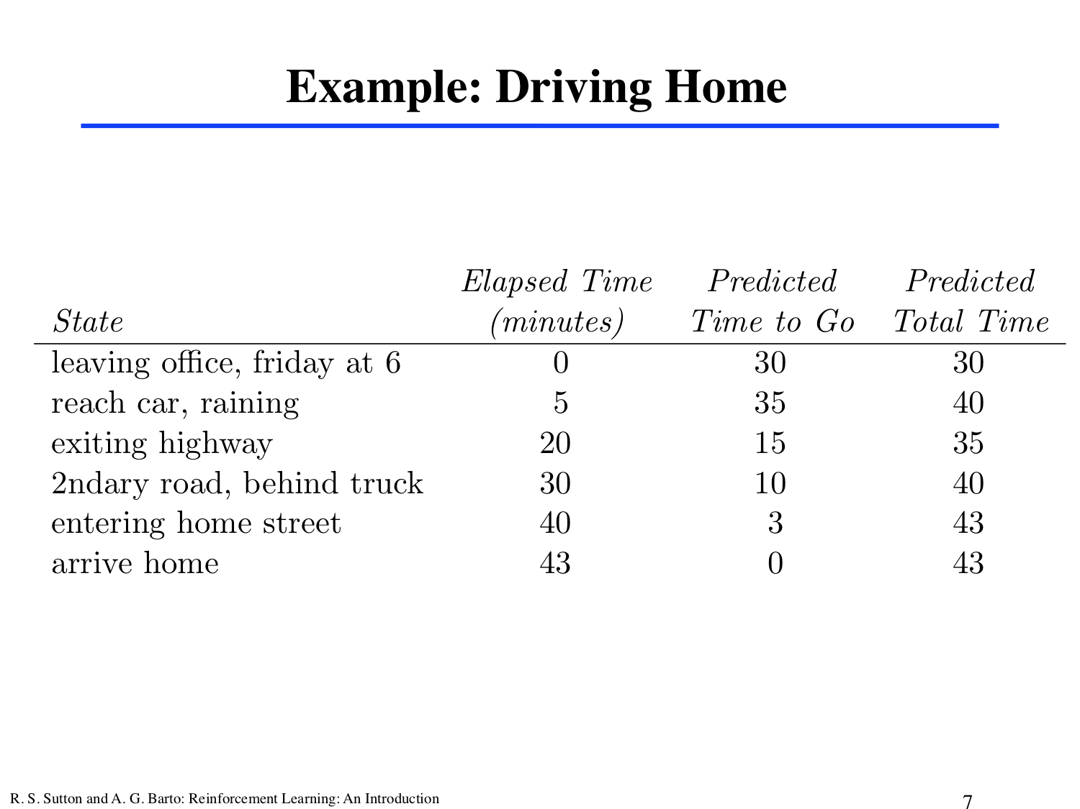

Slide 14

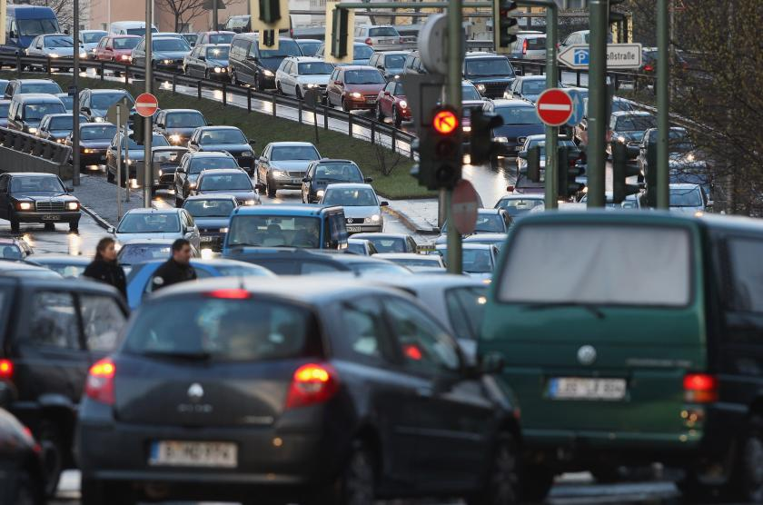
Must you wait until you get home before increasing your estimated time?
Should you wait until the final outcome is known before learning can begin?
Monte Carlo approach says YES
TD approach says NO

Slide 15
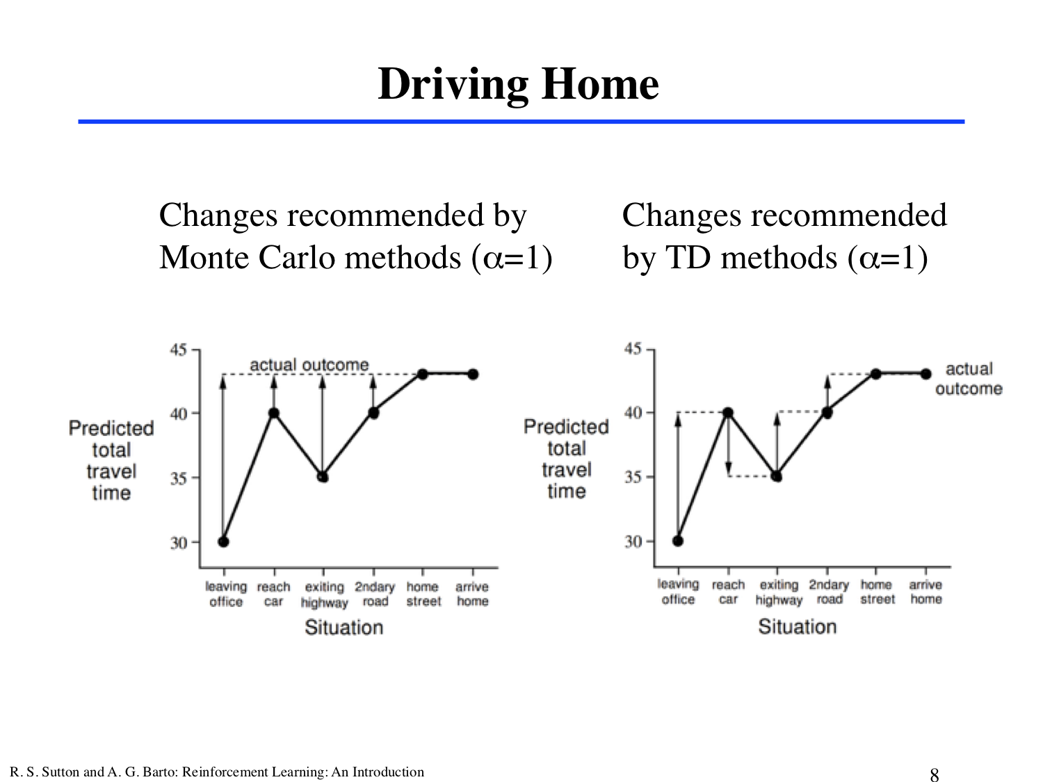
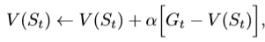
Arrows = changes in predictions recommended by the constant-a MC method, for a = 1.
Notes:
A simple way to view the operation of MC methods = plot the predicted total time!
The arrows = exact errors between the estimated value (predicted time to go) in each state and the actual return (actual time to go).
Equation 6.1 applies at this point and determines an increment in the estimate of time to go after existing the highway.
The error, G_t - V(S_t) (at this time is 8 minutes ).
Figure 6.1 (right) shows the changes in the predictions recommended by the TD rule; each error is proportional to the change over time of the prediction = temporal differences in predictions.

Slide 16
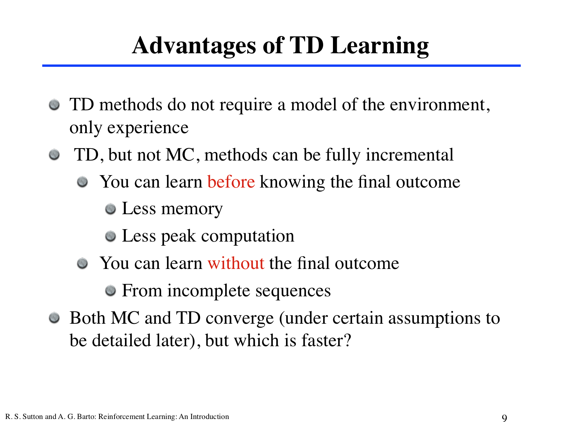

Slide 17
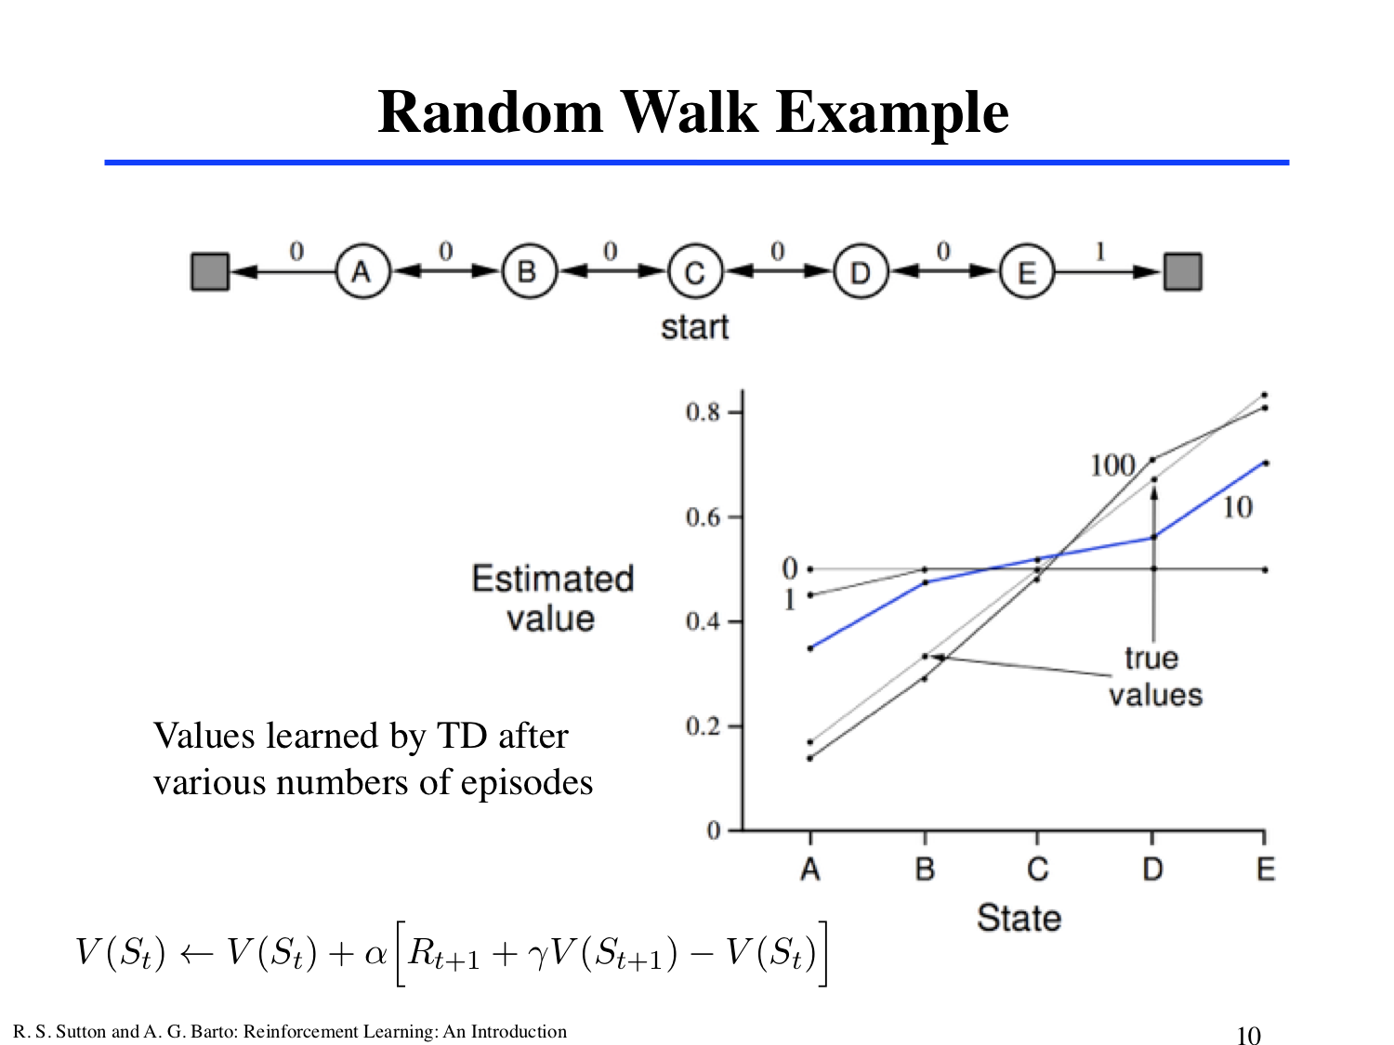
1
Notes:
This example
Empirically compare the prediction abilities of TD(0) and a constant-a MC when applied to the following Markov reward process:
1) Markov reward process (MRP) : MDP without actions. 예측 문제만 보고자 할 때 MRP를 쓴다. (no need to distinugish the dynamics due to the environment from those due to the agent).
B/C this task = undiscounted, the true value of each state is the probability of terminating on the right if starting from that state. Thus, the true value of the center state is v_pi(C) = 0.5. The true values of all the states, A through E, are ⅙,2/6,3/6, 4/6, and ⅚.
The graph = values learned after various numbers of episodes on a single run of TD(0).
The estimates after 100 episodes are about as close as they ever come to the true values (with a constant step-size parameter :alpha)

Slide 18
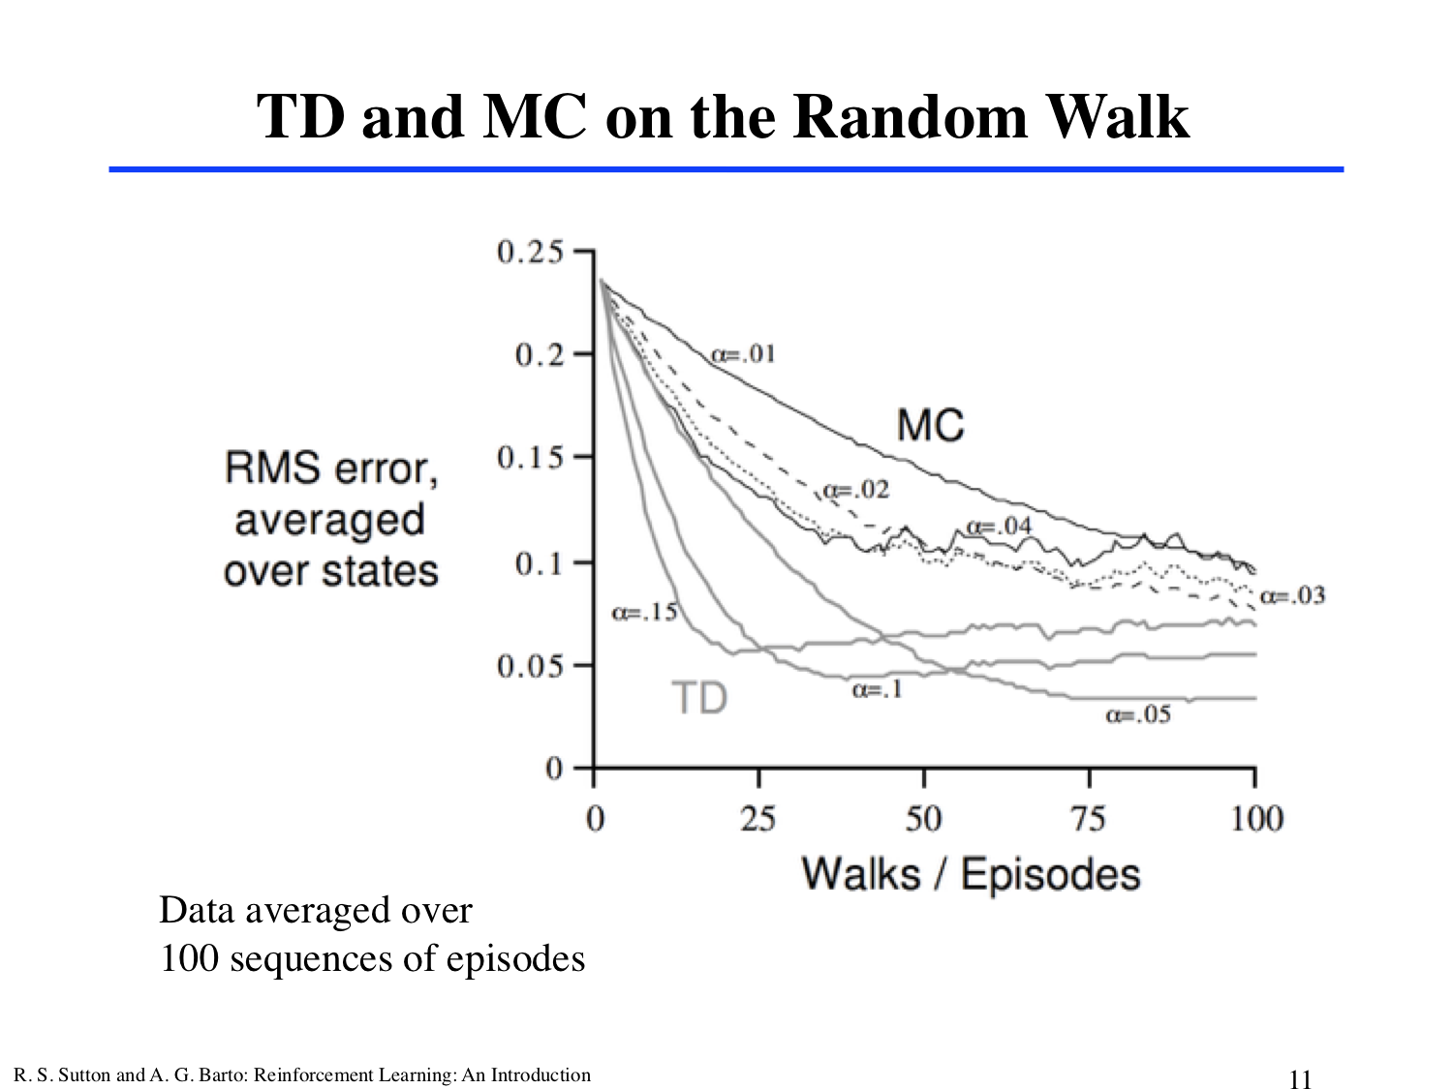
Notes:
Learning curves for the 2 methods for various values of alpha.
The performance measure shown is the root mean-squared (RMS) error between the value function learned and the true value function, averaged over the ﬁve states, then averaged over 100 runs.
In all cases the approximate value function was initialized to the intermediate value V (s) = 0.5, for all s. The TD method was consistently better than the MC method on this task.

Slide 19
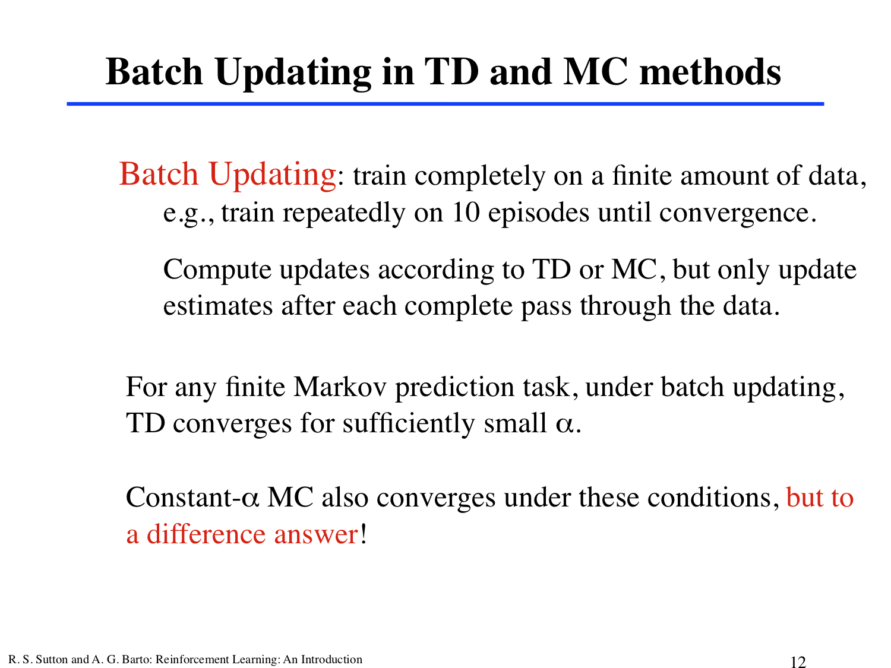

Slide 20
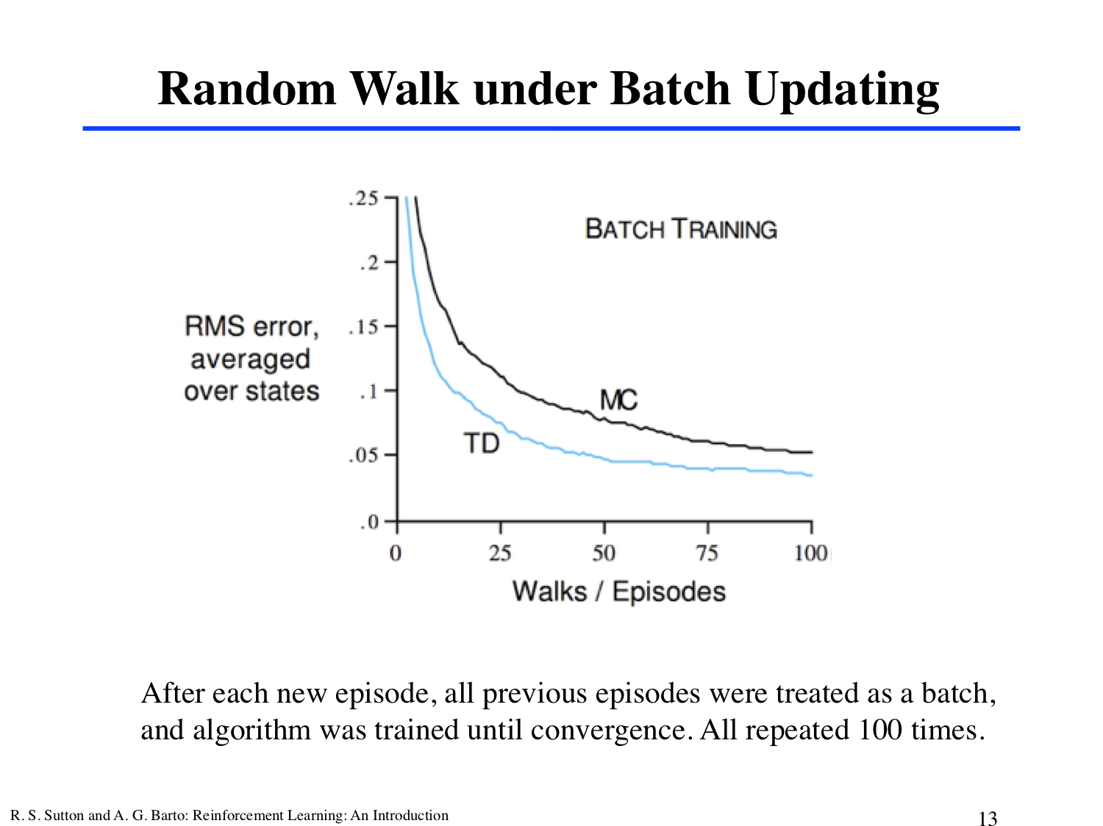

Slide 21
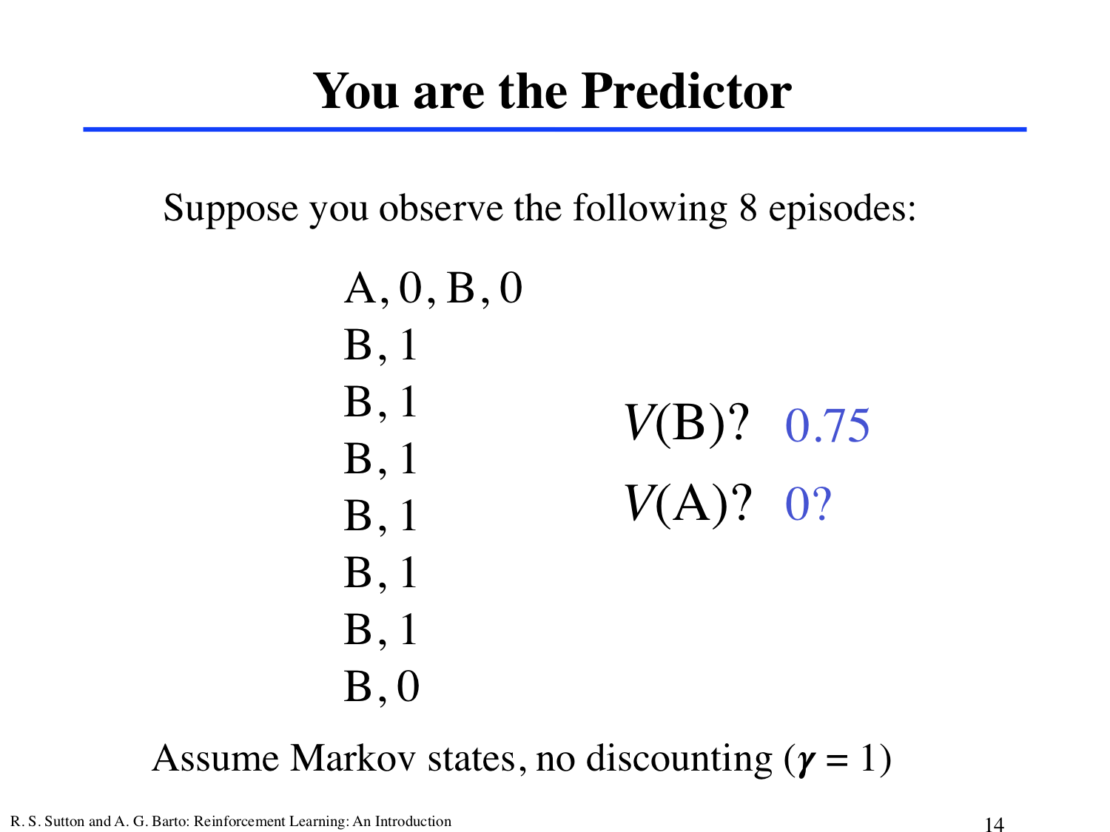

Slide 22
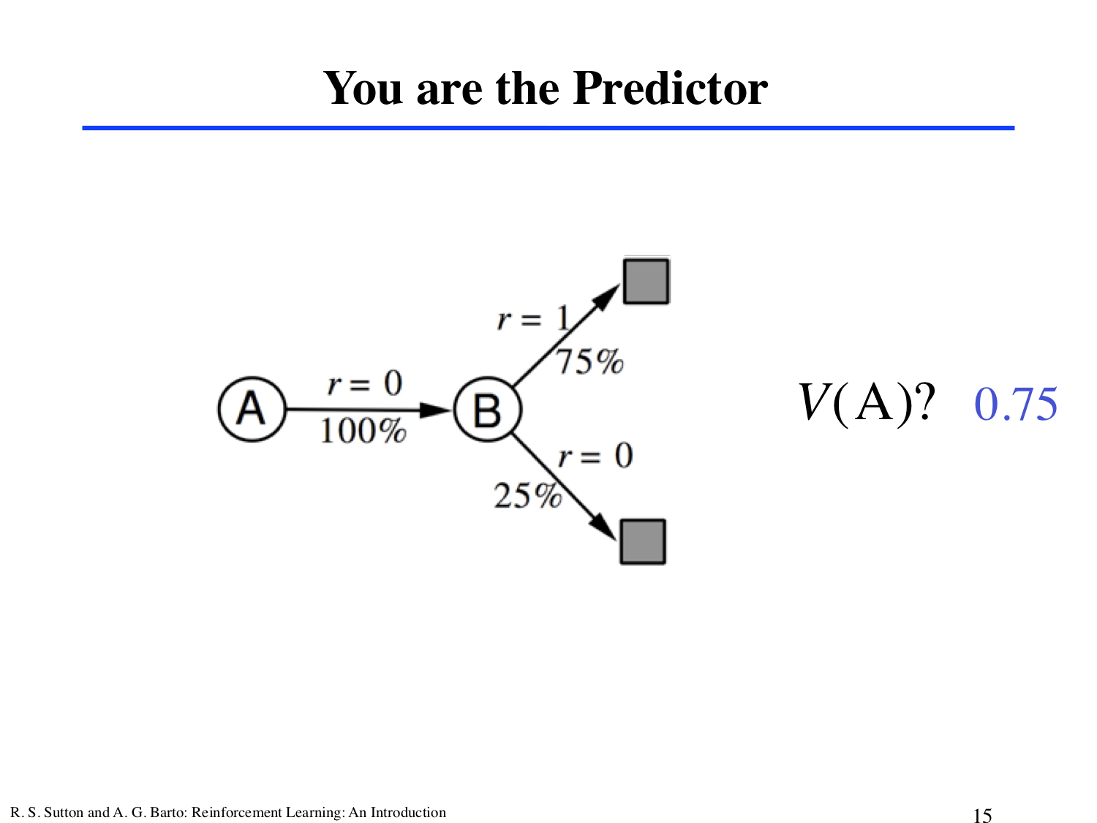

Slide 23
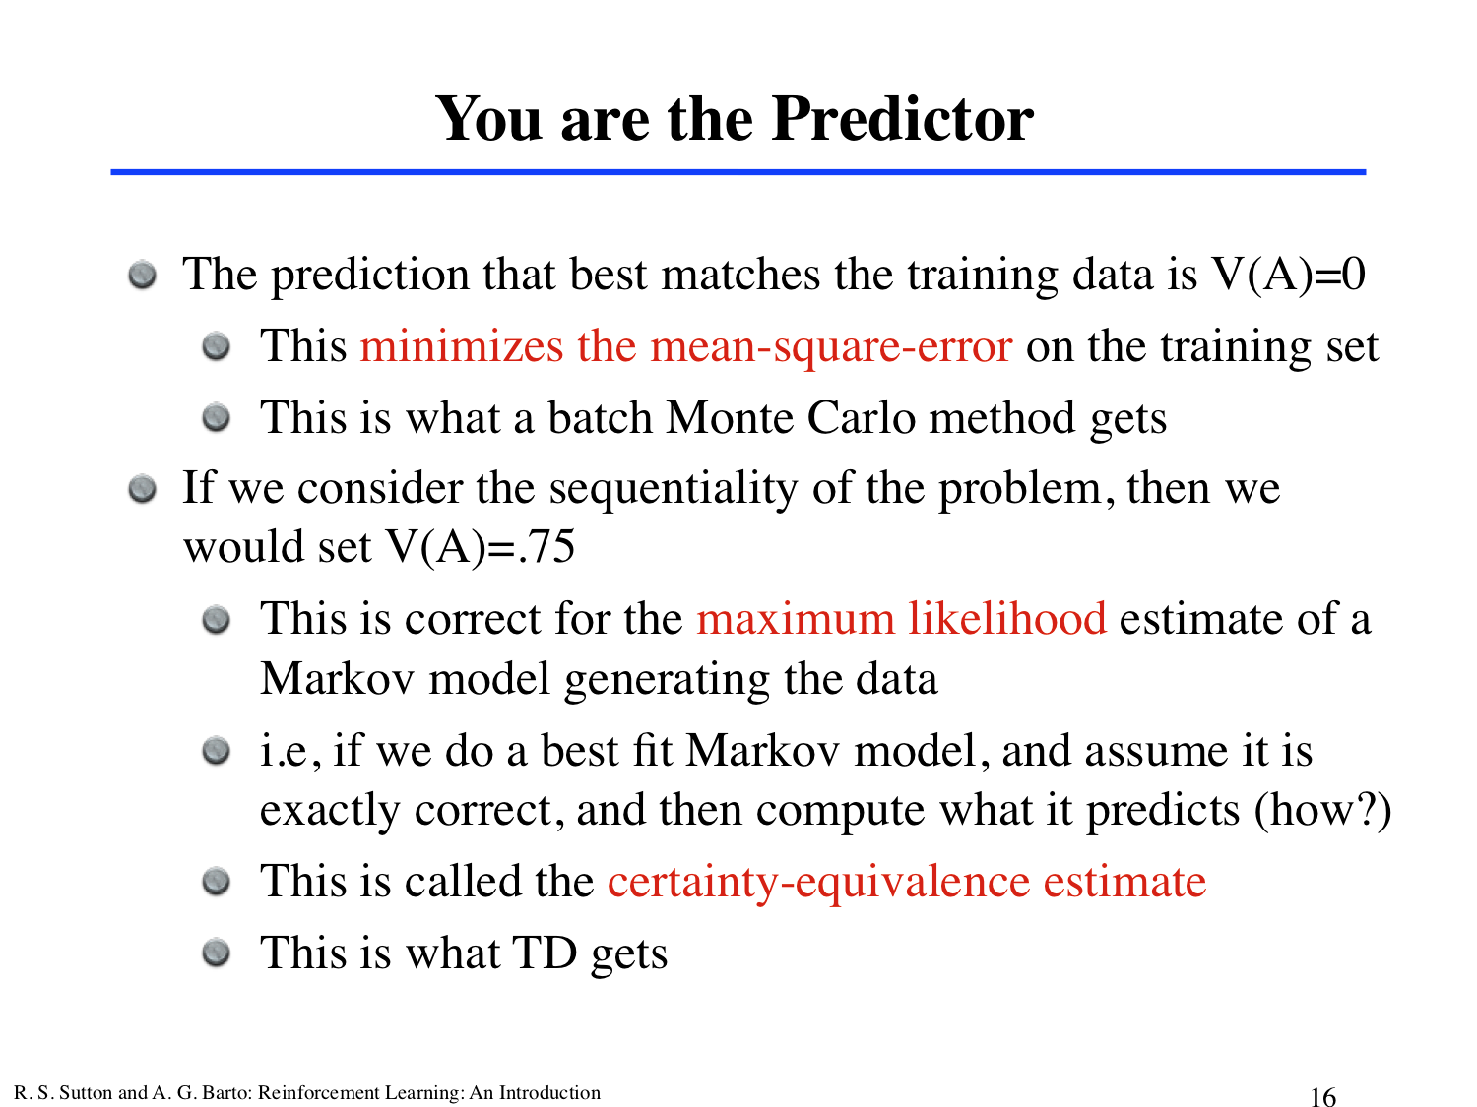

Slide 24
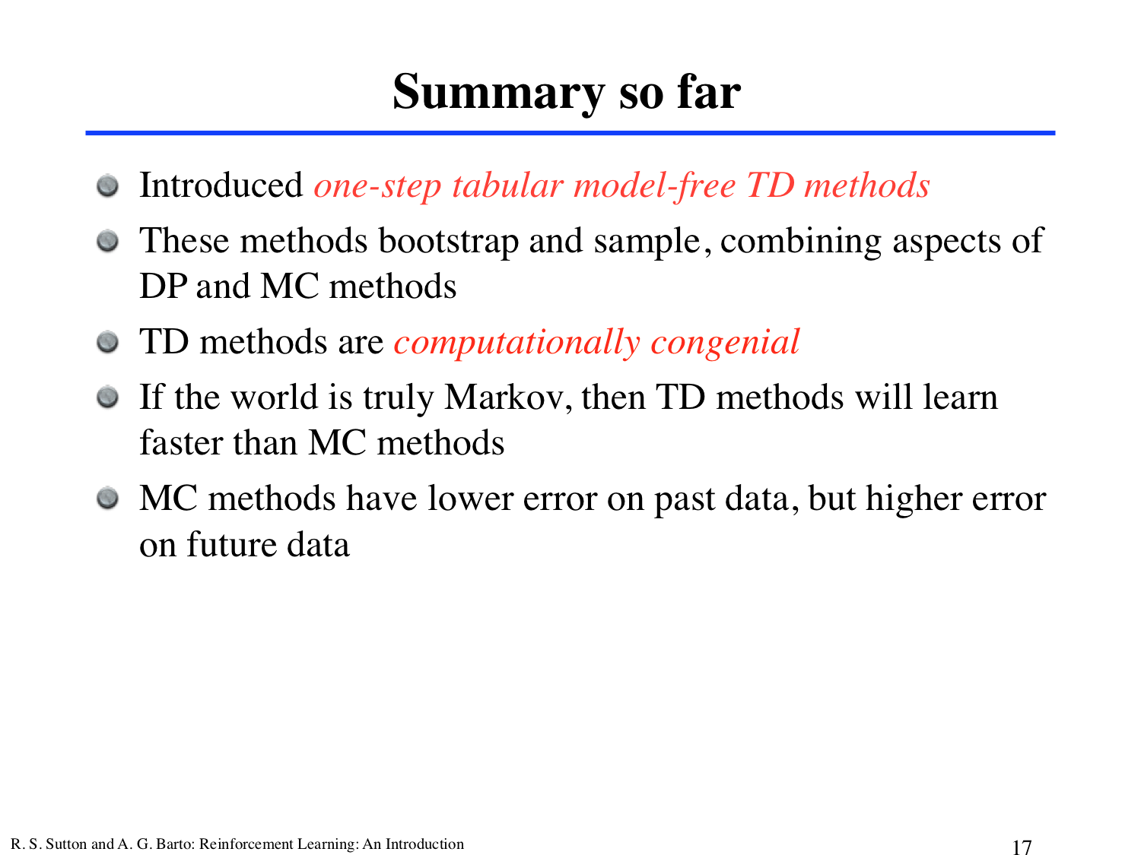

Slide 25
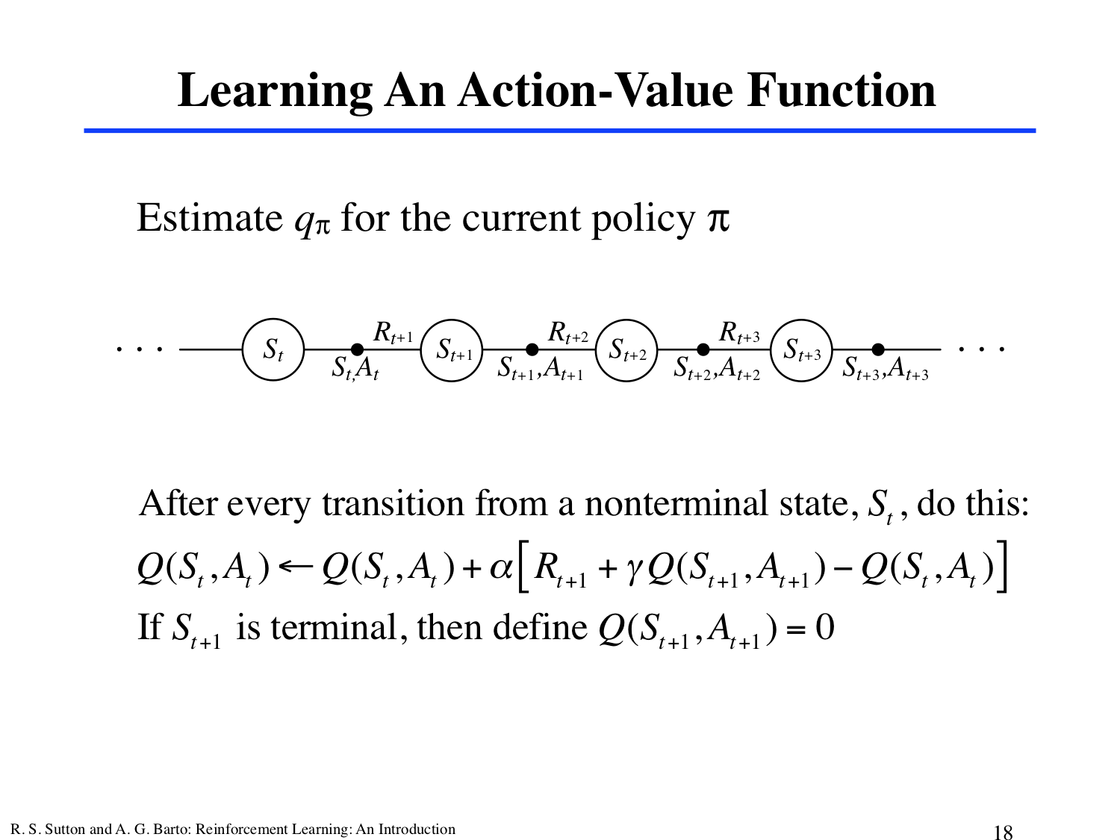

Slide 26
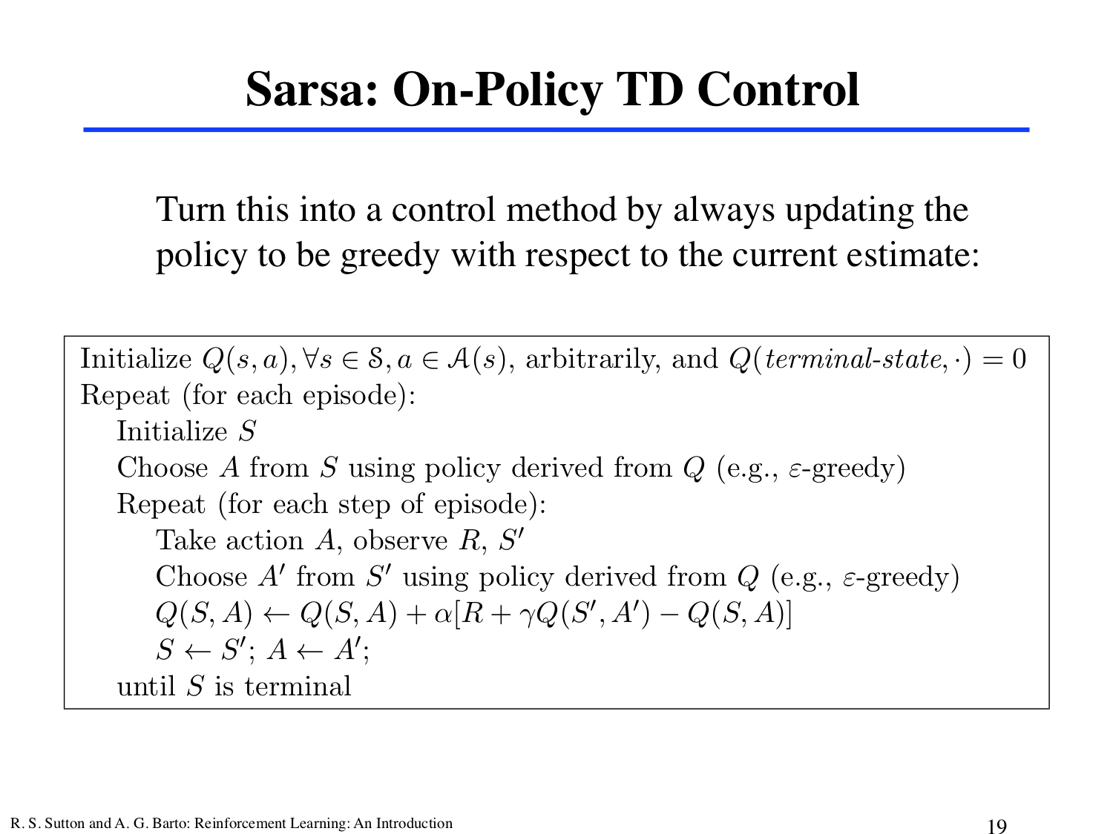

Slide 27
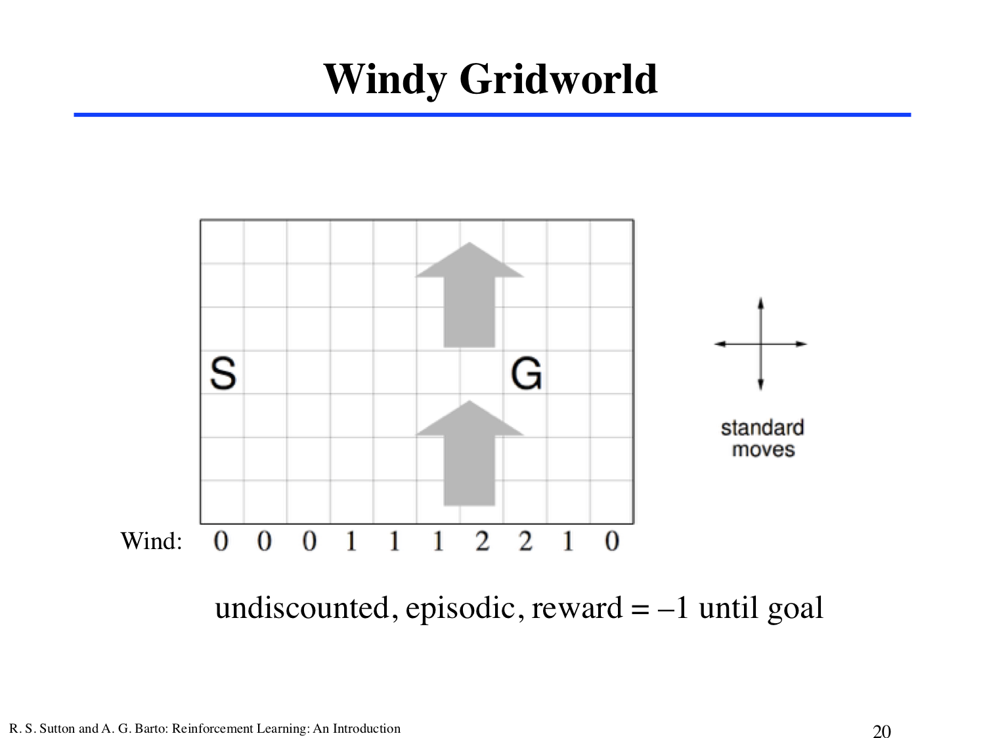

Slide 28
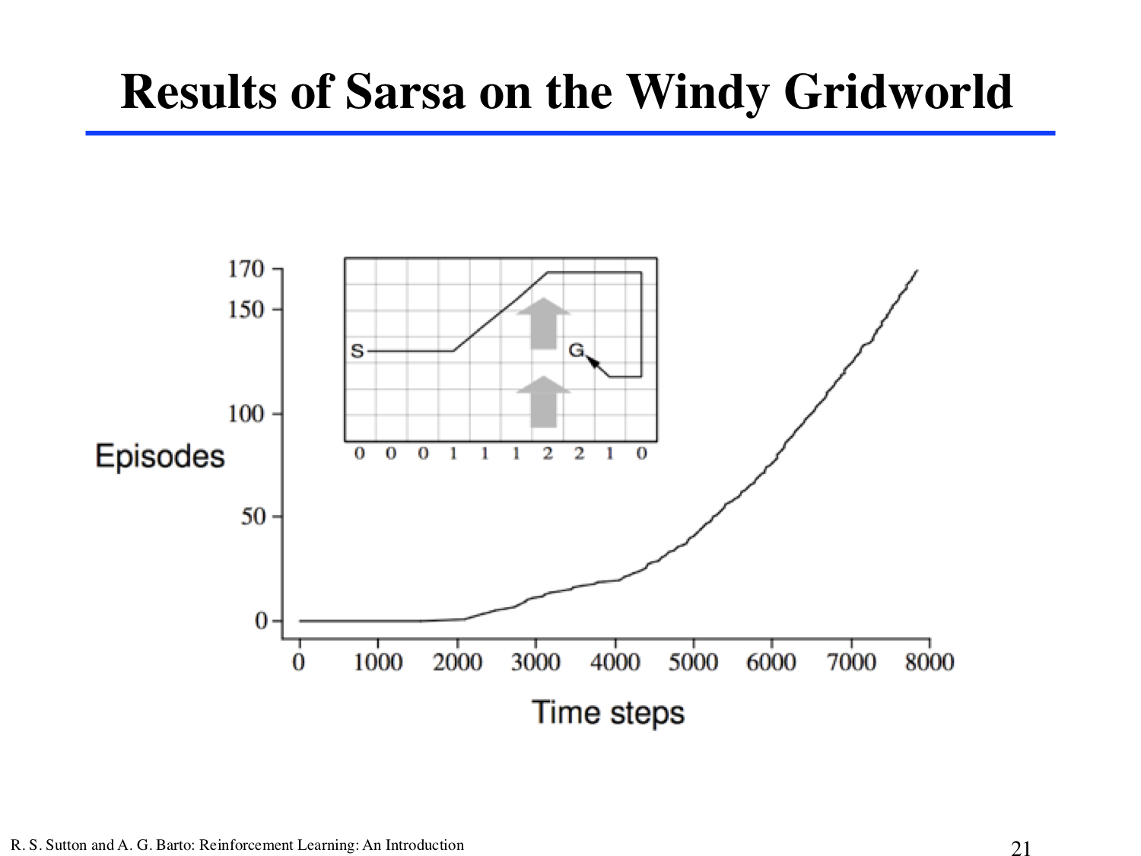

Slide 29
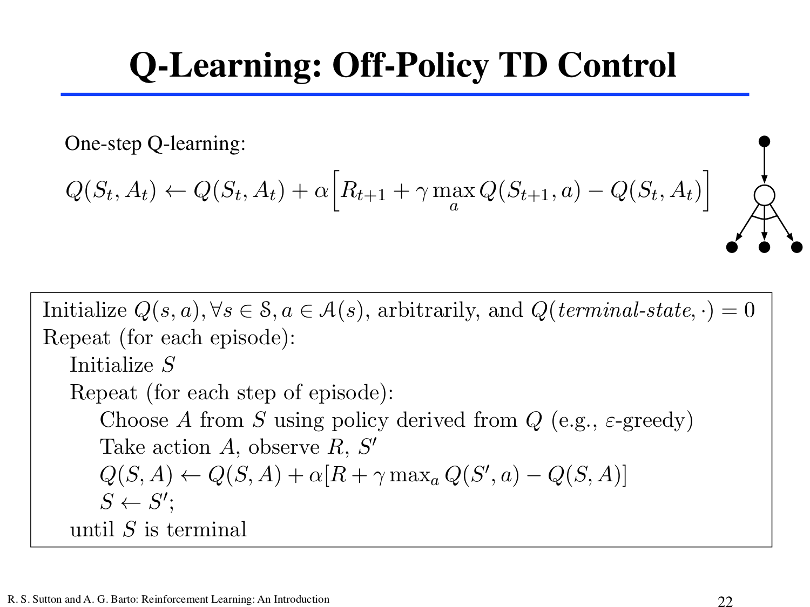

Slide 30
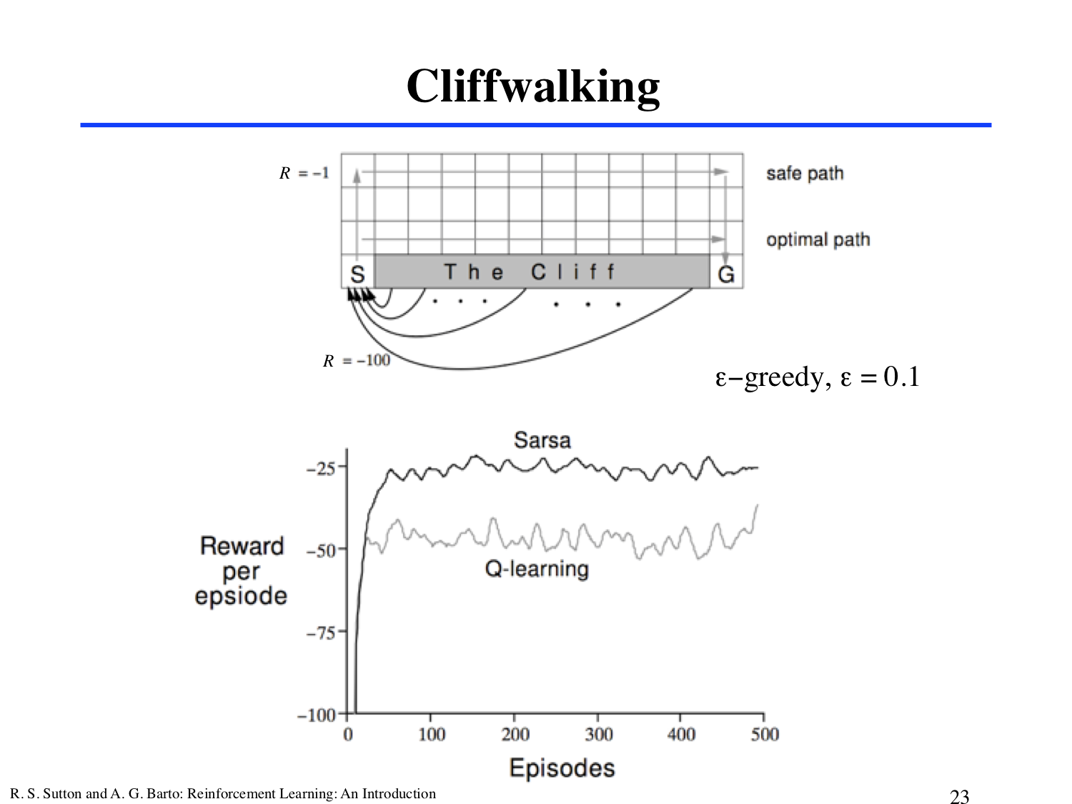

Slide 31
The end

